Slide 1


Online Detection of Outstanding Quantiles with QuantileFilter
Yuhan Wu, Aomufei Yuan, Zhouran Shi, Yuanpeng Li,
Yikai Zhao, Peiqing Chen , Tong Yang , and Bin Cui
Peking University, China
ICDE 2024, May 13–17, 2024
Utrecht, Netherlands.
Notes:
Good morning, everyone! I am Yikai Zhao, a Ph.D. student from Peking University. This is Yuhan Wu, also a Ph.D. student from Peking University. Today, we are honored to present our work, "Online Detection of Outstanding Quantiles with QuantileFilter," at the ICDE conference.

Slide 2
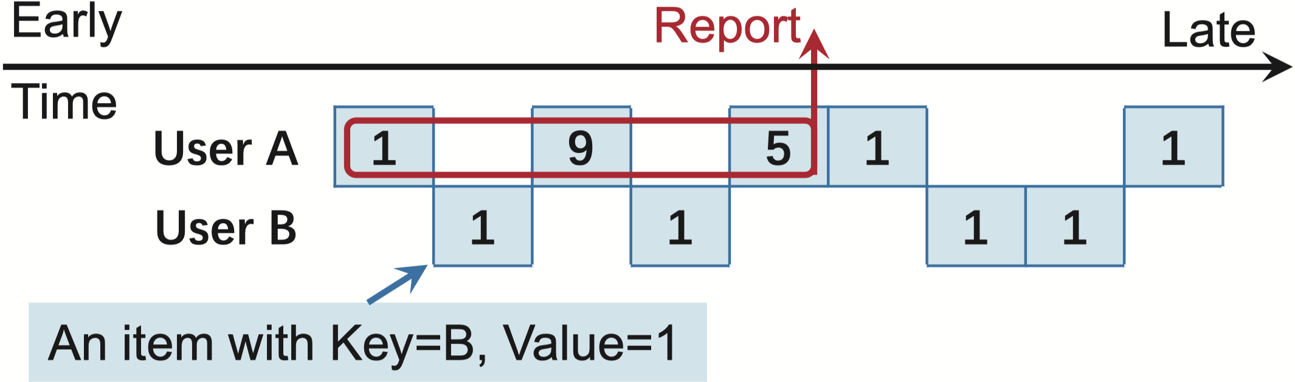
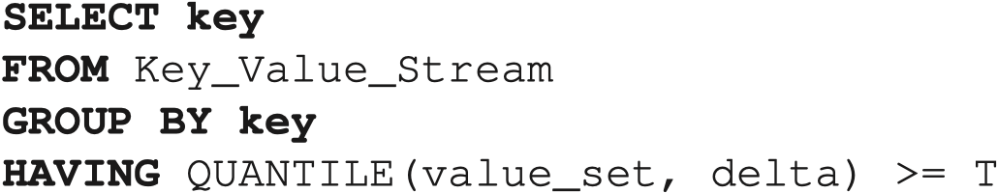
Background: Outstanding Quantiles
Outstanding Quantiles (𝛿 -quantile)
0.5-quantile ≥ 3
SQL statement
Notes:
First, let's understand what "Outstanding Quantiles" are. We focus on a multi-user data stream scenario. In this data stream, each item has a key that indicates which user it belongs to, along with an attribute value. For example, the first three items in the data stream shown on the slide are (A, 1), (B, 1), and (A, 9).
Given a delta between 0% and 100%, such as 50%, we can calculate a delta quantile for each user. For example, if user Alice's values are 0, 9, and 5, her 50% quantile is 5. If a user's delta quantile exceeds a preset threshold T, such as 3, we say that an Outstanding Quantile is detected for that user. In the example on the slide, user Alice has Outstanding Quantiles, while user Bob does not.
1 MIN 30 SEC

Slide 3
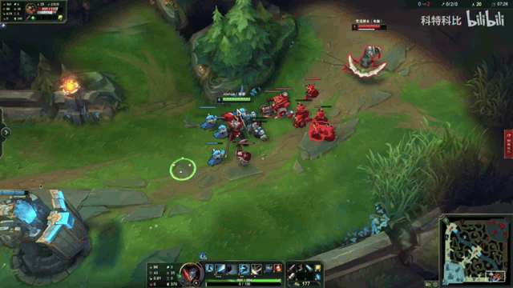
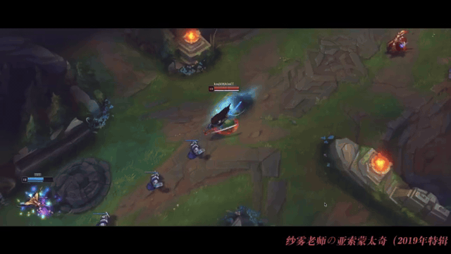
Background: Outstanding Quantiles
Outstanding Quantiles
network tail latency monitoring
system performance monitoring
Online games with high 99% latency
Online games with low 99% latency
Notes:
Outstanding Quantiles are crucial in many real-world scenarios, particularly in network monitoring contexts for tail latency, such as 99% latency. Compared to network bandwidth or average latency, changes in 99% end-to-end latency have a greater impact on user experience. For example, in online games like League of Legends, players can perform smoothly with low 99% latency, but with high 99% latency exceeding 100 milliseconds, they may struggle, even if they can usually play normally. Therefore, enabling network administrators to detect outstanding 99% latency in real-time is very meaningful.

Slide 4

Background: Outstanding Quantiles
Outstanding Quantiles
[R1] Fast online computation
Online Insertion (> 10 MOPS)
Online Query (> 10 MOPS)
[R2] Efﬁcient space usage
Programmable network devices (∼ 10MB SRAM)
Sensor devices (∼ 10KB RAM, 1MB flash)
Notes:
To monitor Outstanding Quantiles in a data stream in real-time, what requirements should we have for online streaming algorithms or data structures? First, we need the data structure to perform fast online computation. We want the insertion and query speed to reach at least 10 million operations per second because most network interface cards send and receive packets at this speed. Second, we need the data structure to use space efficiently. To measure network traffic in real-time, we need to deploy this data structure on network devices like programmable switches or smart NICs, which typically have around 10 million bytes of SRAM available.
3 MIN

Slide 5
Prior Art: quantile estimation algorithms
Single-key quantile estimation algorithms
GK [SIGMOD’01], q-digest [SenSys’04], KLL [FOCS’16], DDSketch [VLDB’19]
not suited for multi-key scenarios
Distribution-Sensitive
Notes:
Can existing streaming algorithms meet these two requirements? Let's review the previous work. Algorithms that estimate quantiles in a data stream can be divided into two categories. The first category can only estimate the quantiles of a single user, including the GK sketch proposed 20 years ago, q-digest, and more recent KLL sketch and DD sketch. These algorithms support queries for any delta quantile, such as 50% quantile, 95% quantile, or 99% quantile. However, extending these single-user quantile sketches to multi-user quantiles is not straightforward. Additionally, these algorithms are sensitive to the distribution of attribute values. For example, DD sketch uses buckets with exponentially increasing widths to approximate histograms. If the data is logarithmically uniformly distributed, DD sketch can provide accurate estimates for both 50% and 95% quantiles. But if the data is uniformly distributed, the accuracy of DD sketch for the 99% quantile will significantly decrease.

Slide 6
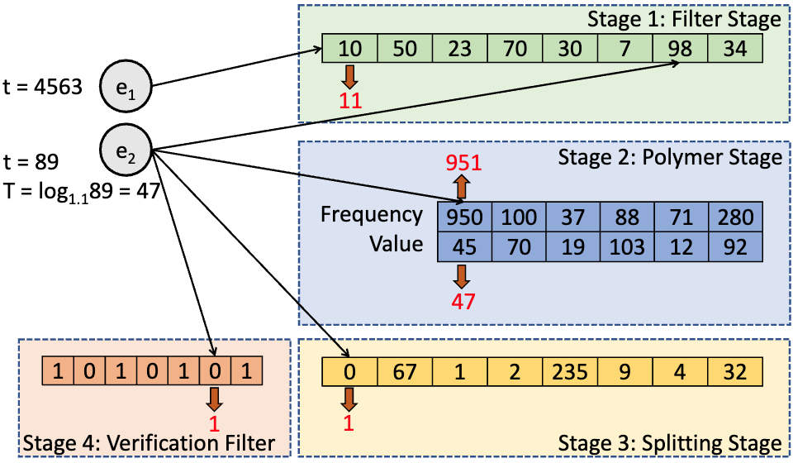
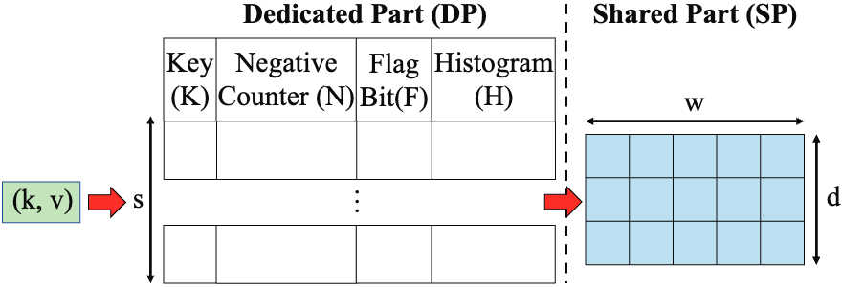
Prior Art: quantile estimation algorithms
Multi-key quantile estimation algorithms
SQUAD [SIGMOD’23]
SketchPolymer [KDD’23]
HistSketch [ICDE’23]
Computational and storage efficiency issues
Offline, not real-time queries
Do not have small constant query times
SketchPolymer: multi-key DDSketch
HistSketch: multi-key histogram
Notes:
The second category can estimate quantiles for each user in a data stream, mostly proposed in the past two years, including SQUAD, SketchPolymer, and HistSketch. These are mainly extensions of the first category of quantile sketches. For example, SketchPolymer extends DD sketch to a multi-user version using some shared techniques. However, the computational and storage overheads of these sketches are substantial. So, can existing algorithms meet the requirements of speed and space usage? The answer is no.

Slide 7
Naïve Solution
𝛿 -quantile ≥ T → quantile(T) ≤ 𝛿
0.8-quantile(blue) < 5500 → quantile(blue, 5500) > 0.8
0.8-quantile(orange) > 5500 → quantile(orange, 5500) < 0.8
Notes:
Next, I will introduce our novel sketch algorithm. Our first observation is that since the delta in the definition of Outstanding Quantiles is predetermined, we do not require the algorithm to answer any quantile for each user. We do not even need the algorithm to provide each user's delta quantile. Look at the example on the slide: the 80% quantile for the blue user does not exceed the preset threshold of 5500, while the 80% quantile for the orange user exceeds the threshold. We can also determine whether a user has Outstanding Quantiles from another perspective: whether the quantile corresponding to the threshold of 5500 exceeds 80%. For the blue user, the quantile corresponding to 5500 is about 90%, while for the orange user, it is about 70%. Therefore, we only need to monitor whether the quantile corresponding to the preset threshold T exceeds delta for each user's attribute value distribution.
6 MIN

Slide 8
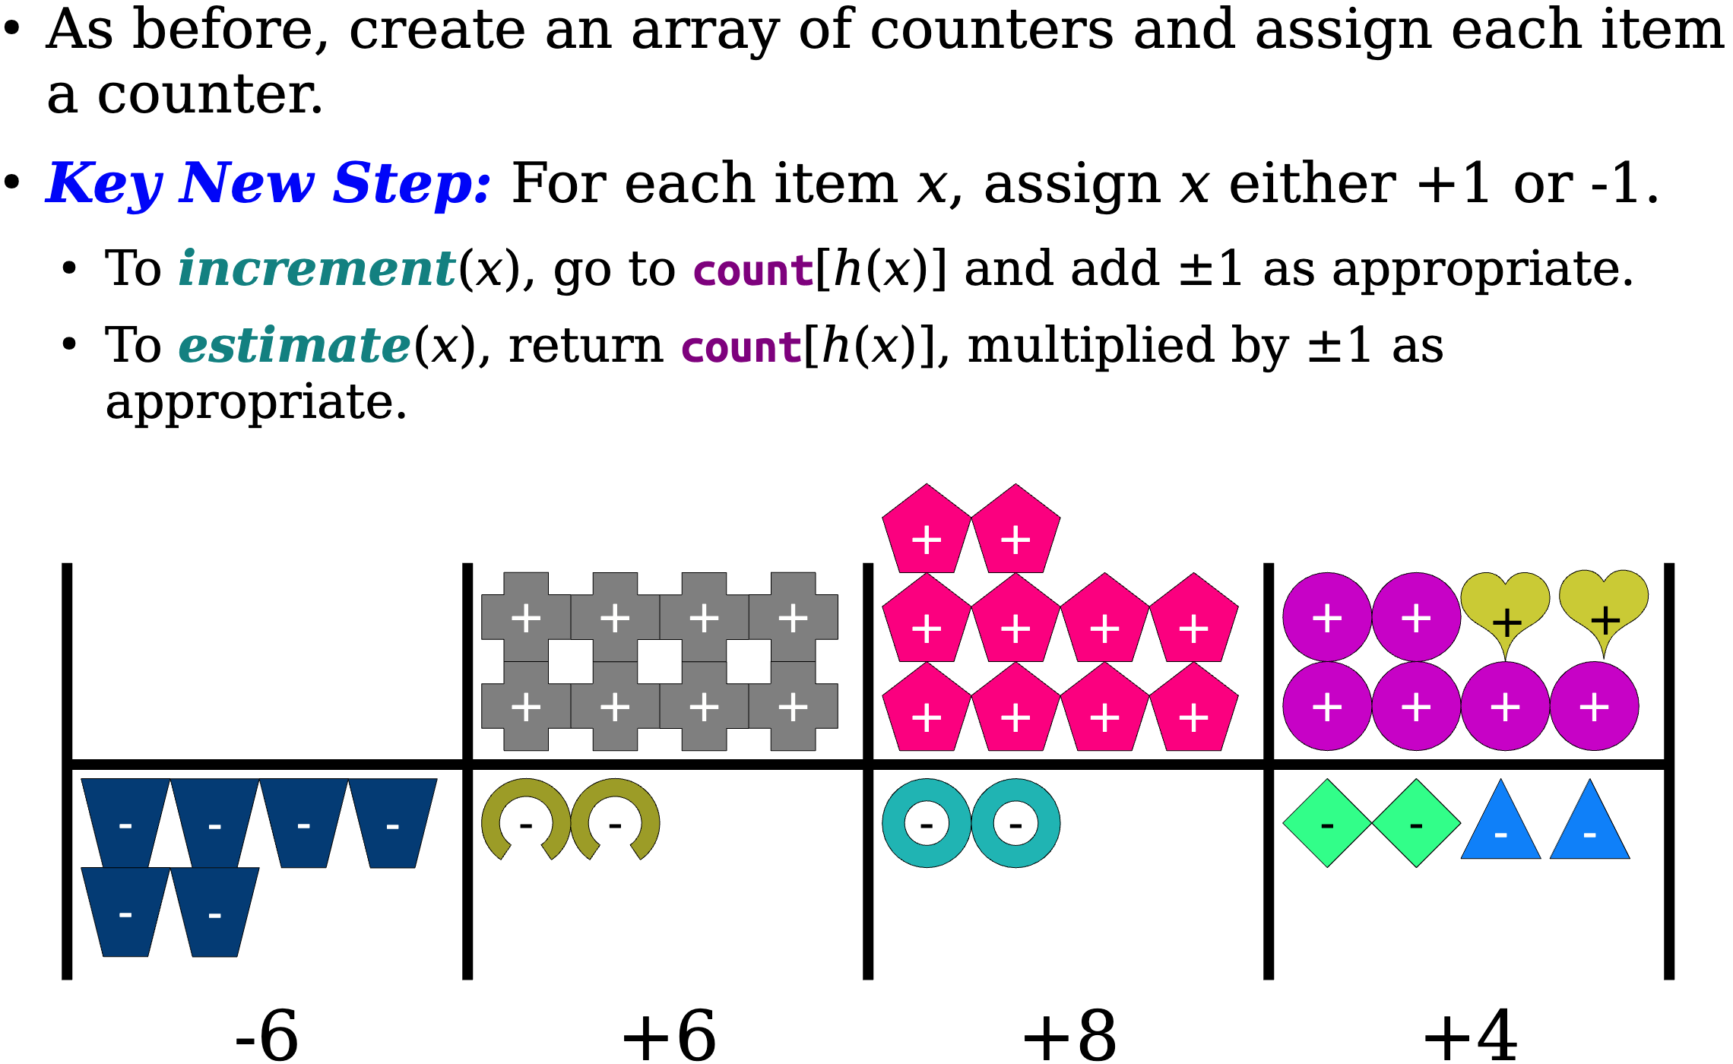
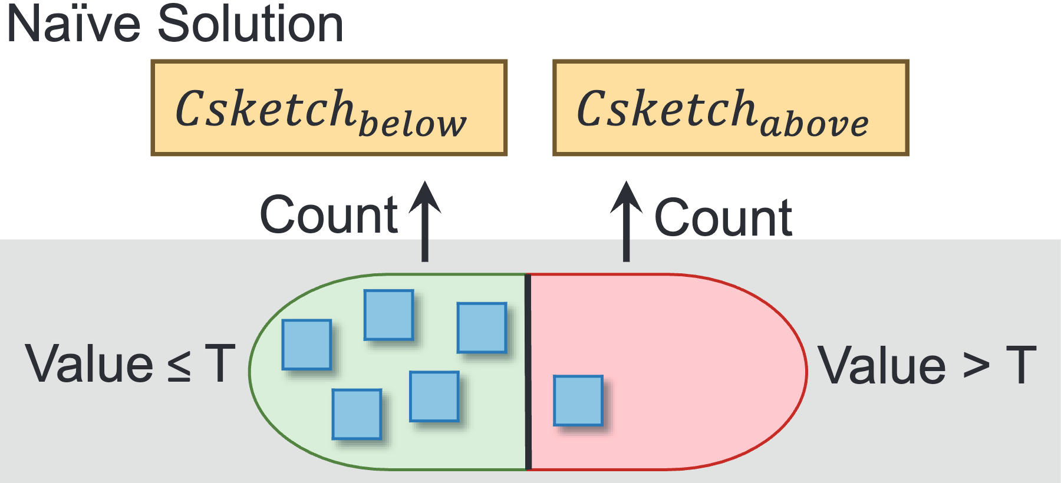
Naïve Solution
Naïve solution
employ two Csketches to count values that either exceed or do not meet the threshold T
Operation for Csketch
Notes:
From this perspective, we propose a naive algorithm for real-time monitoring of Outstanding Quantiles, using a sketch algorithm called C-sketch. C-sketch is a classic algorithm for multi-user data streams, capable of counting how many items belong to each user in the data stream. The C-sketch data structure is an array of counters, and it uses a hash function h to assign a counter to each user, meaning multiple users may share a counter. C-sketch also uses another hash function s to randomly assign each user to be a positive or negative user. When a new item for user Alice arrives, if Alice is a positive user, C-sketch increments the corresponding counter by 1; if Alice is a negative user, C-sketch decrements the counter by 1. Each user can use the value of their counter as an estimate of their item frequency, and this estimate is provably unbiased.
Our naive algorithm is easy to understand. It uses two C-sketches. For each new item belonging to user Alice, if the attribute value does not exceed the threshold T, it is inserted into the first C-sketch; if it exceeds T, it is inserted into the second C-sketch. Then, we query the number of items for user Alice that exceed and do not exceed T from the two sketches, respectively, and estimate the quantile of T. If the quantile does not exceed delta, we report that user Alice has Outstanding Quantiles.
8 MIN

Slide 9
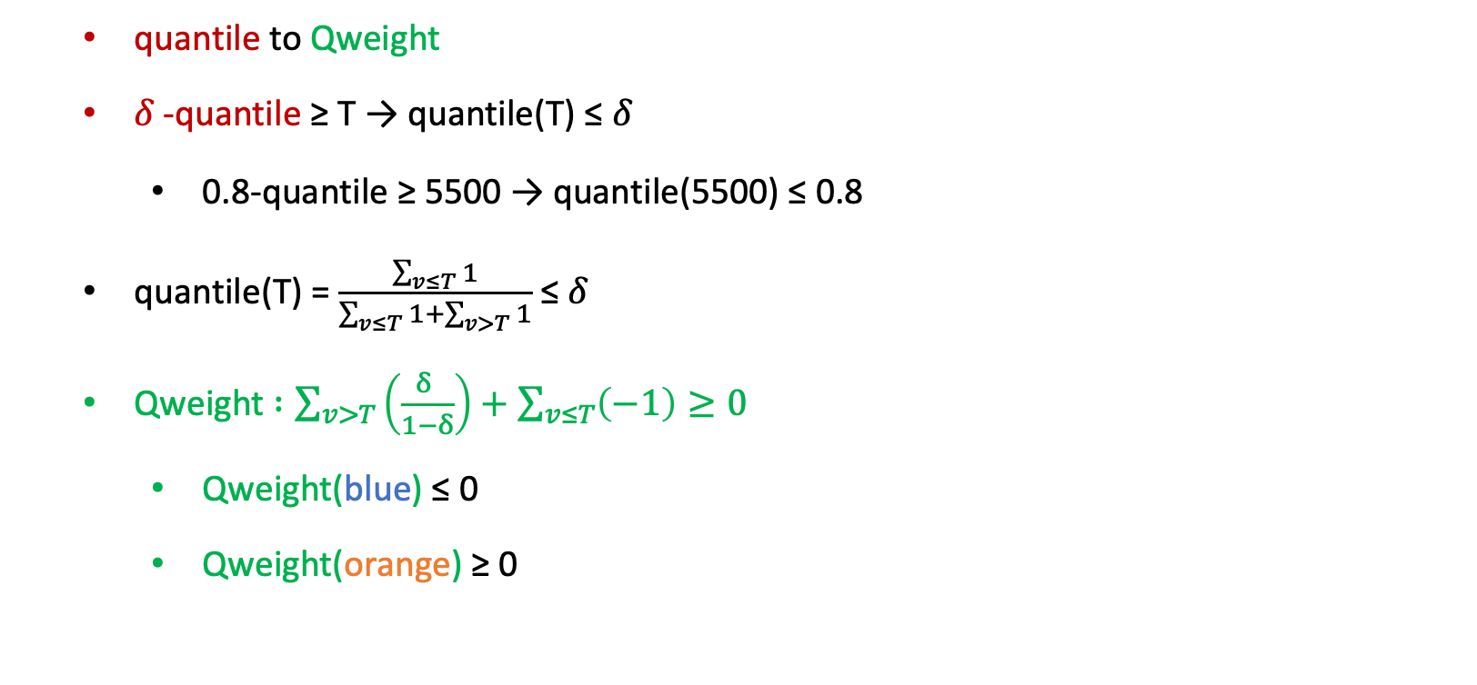
Motivation: quantile to Qweight
quantile to Qweight
𝛿 -quantile ≥ T → quantile(T) ≤ 𝛿
0.8-quantile ≥ 5500 → quantile(5500) ≤ 0.8
quantile(T) = $\frac{\sum_{v≤T}{1}}{\sum_{v≤T}{1}+\sum_{v>T}{1}}$ ≤ 𝛿
Qweight $:\sum_{v>T}{\left(\frac{δ }{1−δ}\right)}+\sum_{v≤T}{\left(−1\right)}≥0$
Qweight(blue) ≤ 0
Qweight(orange) ≥ 0
Notes:
However, using two independent C-sketches is somewhat wasteful in terms of space. We next explore how to further save space and improve accuracy. By expanding the formula for the quantile of threshold T, we get the green formula. This means we define a Qweight for each user. Items exceeding T contribute positive weights to the Qweight, and items not exceeding T contribute negative weights. Numerically, if a user's quantile of T exceeds delta, the user's Qweight is positive; otherwise, it is negative. For example, the blue user's Qweight is positive, while the orange user's Qweight is negative.

Slide 10

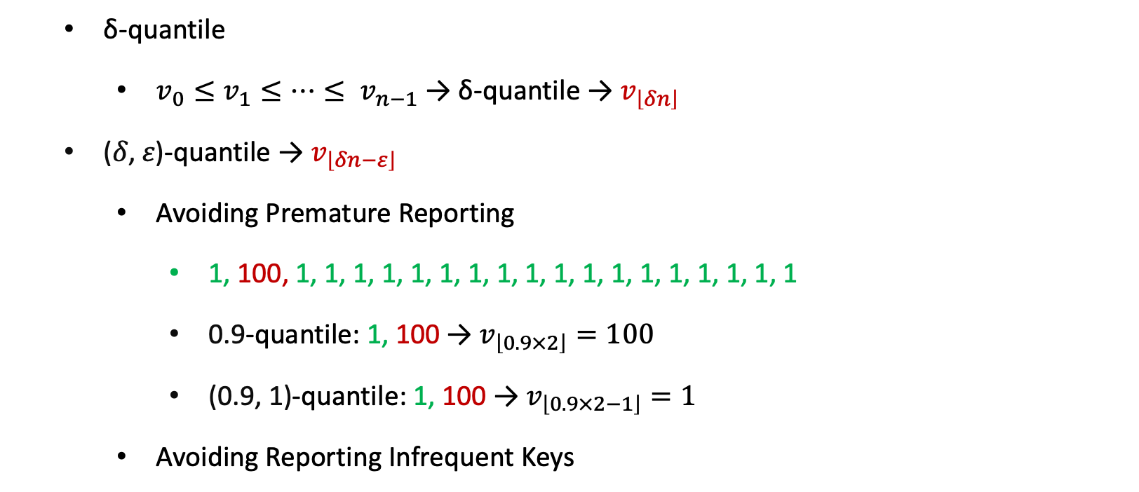
Motivation: Generalizing to (𝛿, 𝜀)-Quantile
ẟ-quantile
$v_{0}≤v_{1}≤…≤ v_{n−1}$ → ẟ-quantile → $v_{\left\lfloor δn\right\rfloor }$
(𝛿, 𝜀)-quantile → $v_{\left\lfloor δn−ε\right\rfloor }$
Avoiding Premature Reporting
1, 100, 1, 1, 1, 1, 1, 1, 1, 1, 1, 1, 1, 1, 1, 1, 1, 1, 1, 1
0.9-quantile: 1, 100 → $v_{\left\lfloor 0.9×2\right\rfloor }=100$
(0.9, 1)-quantile: 1, 100 → $v_{\left\lfloor 0.9×2−1\right\rfloor }=1$
Avoiding Reporting Infrequent Keys
Notes:
Next, we introduce a more robust quantile definition than delta quantile: the (delta, epsilon) quantile. If user Alice has n attribute values, the delta quantile is the delta times n-th smallest attribute value, and the (delta, epsilon) quantile is the delta times n minus epsilon-th smallest attribute value. We use a specific example to illustrate the robustness of the (delta, epsilon) quantile. Consider the data stream on the slide: if we use the 0.9 quantile, we immediately think the user has Outstanding Quantiles after observing attribute values 1 and 100. However, if we observe more attribute values, we find it is just a low-probability event. Using the (0.9, 1) quantile, we calculate that the user's (0.9, 1) quantile is 1 after seeing values 1 and 100, avoiding the influence of low-probability events and enhancing robustness.
10 MIN

Slide 11
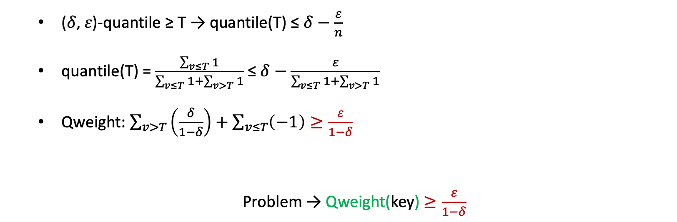
Motivation: (𝛿, 𝜀)-Quantile → Qweight
(𝛿, 𝜀)-quantile ≥ T → quantile(T) ≤ $δ−\frac{ε}{n}$
quantile(T) = $\frac{\sum_{v≤T}{1}}{\sum_{v≤T}{1}+\sum_{v>T}{1}}$ ≤ $δ−\frac{ε}{\sum_{v≤T}{1}+\sum_{v>T}{1}}$
Qweight: $\sum_{v>T}{\left(\frac{δ}{1−δ}\right)}+\sum_{v≤T}{\left(−1\right)}≥\frac{ε}{1−δ}$
Problem → Qweight(key) $≥\frac{ε}{1−δ}$
Notes:
After introducing the (delta, epsilon) quantile, we need to check if our Qweight definition is still applicable. The answer is surprisingly yes. After rearranging the formula on the slide, we find that a user's (delta, epsilon) quantile exceeding T is equivalent to the user's Qweight exceeding epsilon divided by (1-delta).

Slide 12
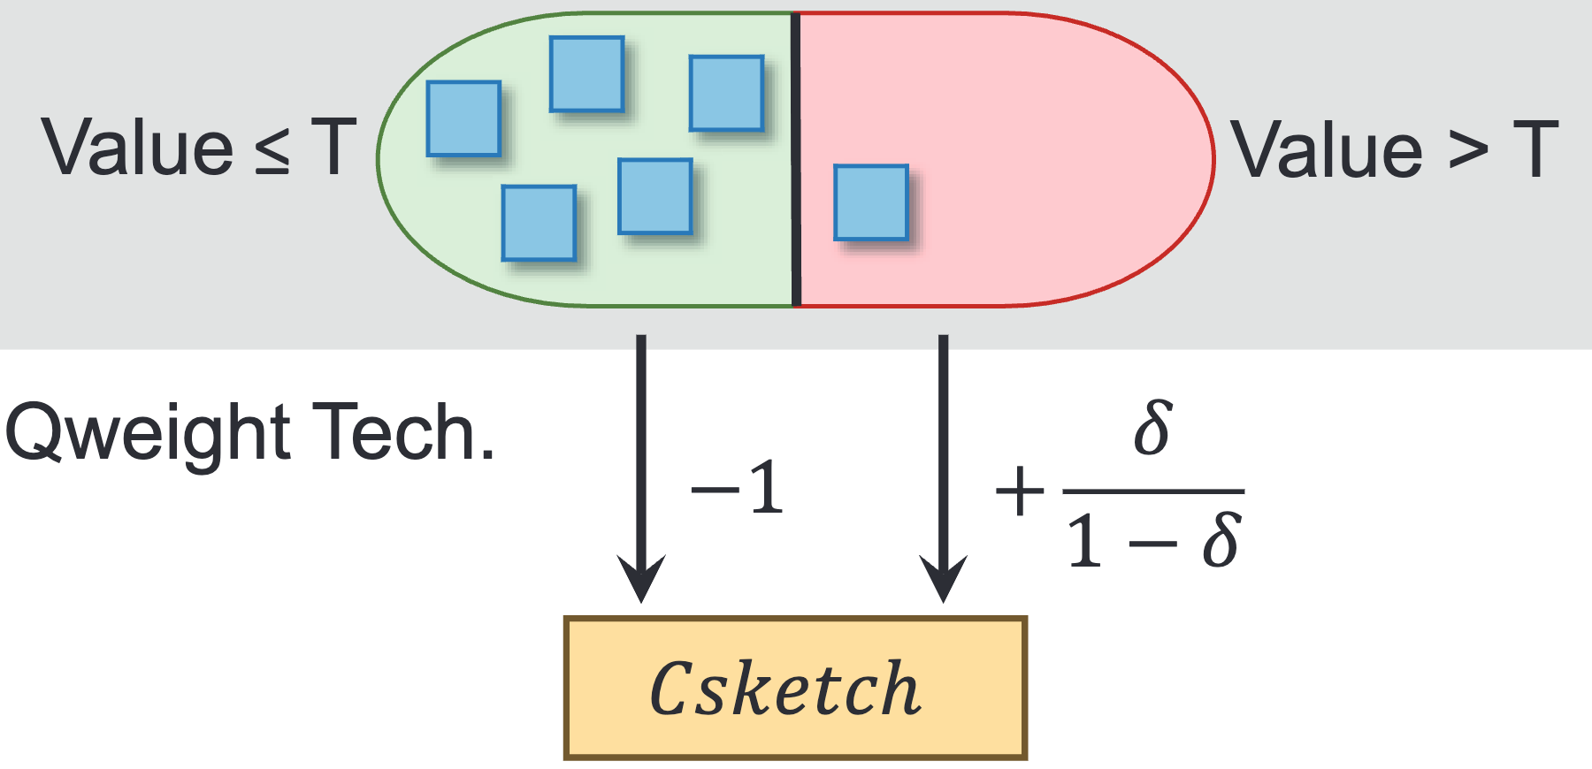
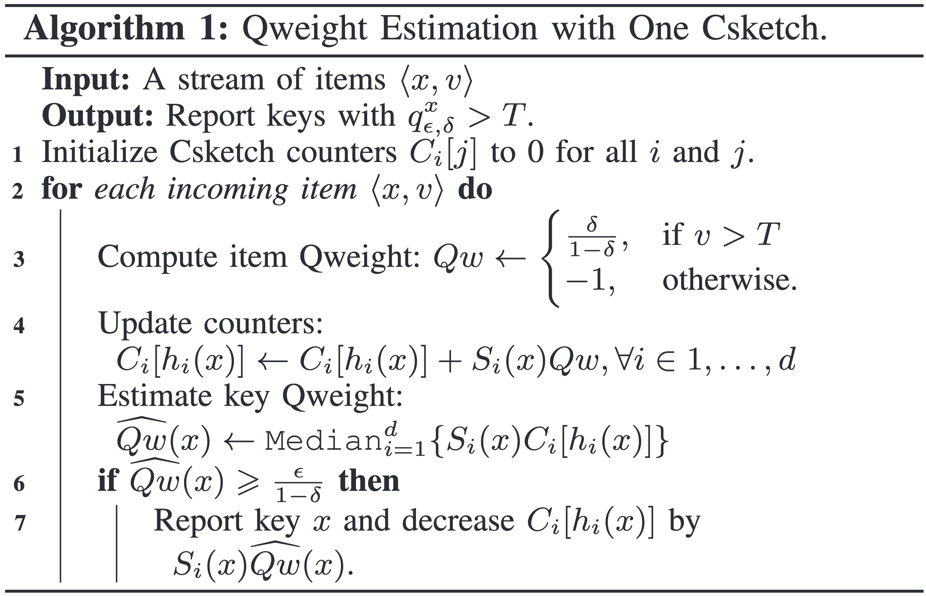
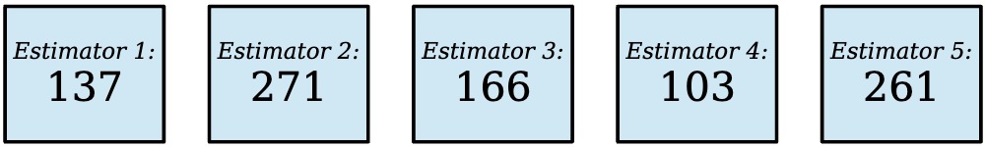
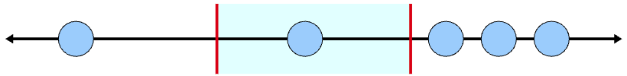
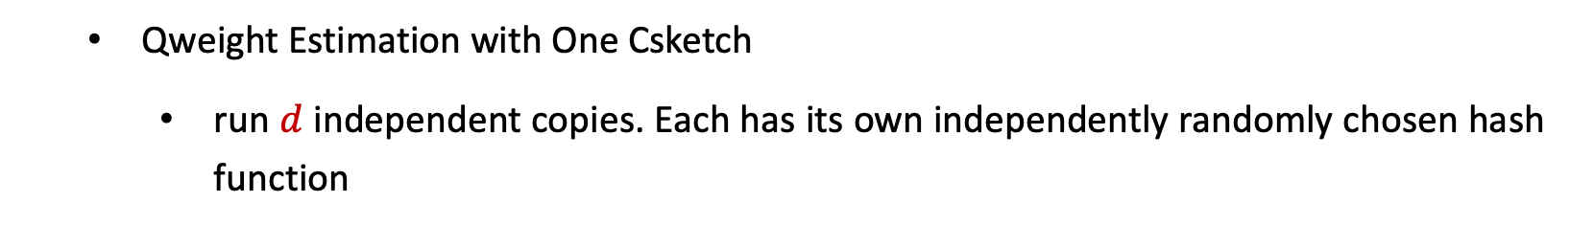
QUANTILE FILTER DESIGN: Quantile Weight Technique
Qweight Estimation with One Csketch
run $d$ independent copies. Each has its own independently randomly chosen hash function
Notes:
Using a single C-sketch can conveniently estimate each user's Qweight. Specifically, for items not exceeding T, we insert items with weight -1 into the C-sketch; for items exceeding T, we insert items with weight delta divided by (1-delta). The C-sketch usually uses multiple counter arrays for estimation, with each array using an independent hash function. Using the median of multiple estimates as the final estimate significantly improves accuracy.

Slide 13
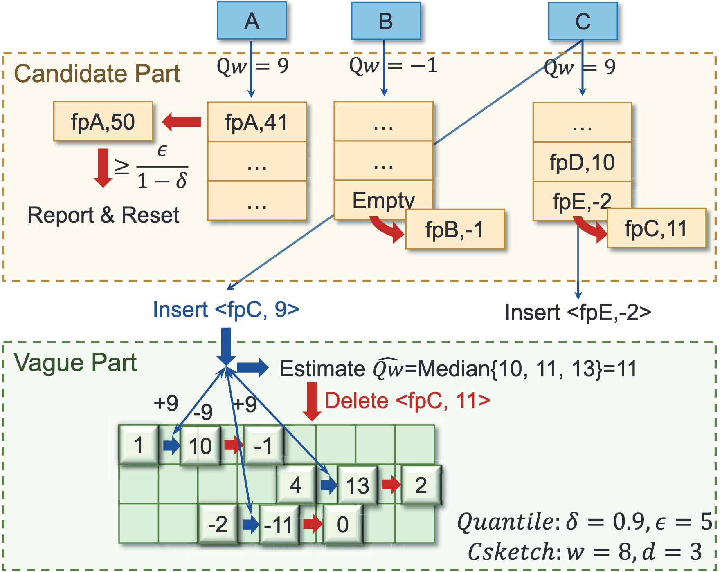
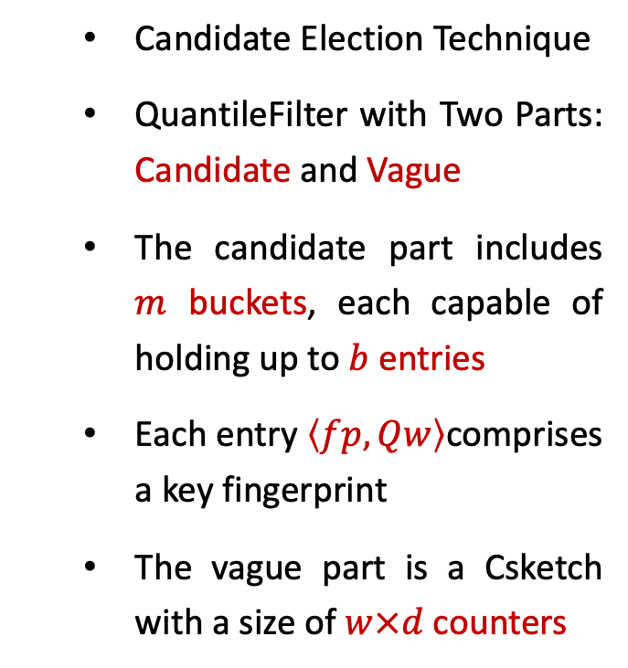
QUANTILE FILTER DESIGN: Candidate Election Technique
Candidate Election Technique
QuantileFilter with Two Parts: Candidate and Vague
The candidate part includes $m$ buckets, each capable of holding up to $b$ entries
Each entry $\left\langle fp, Qw\right\rangle$comprises a key fingerprint
The vague part is a Csketch with a size of $w×d$counters
Notes:
To further improve accuracy, we introduce the candidate election technique, splitting the quantile filter into two parts. The first part is the candidate part, containing m buckets. Each bucket contains b entries, each recording a user's fingerprint and Qweight. The second part is the vague part, a C-sketch with d arrays. We aim to record users with larger Qweights, who are more likely to have Outstanding Quantiles, in the candidate part, while recording users with smaller Qweights in the vague part.

Slide 14
QUANTILE FILTER DESIGN: Candidate Election Technique
Candidate Election Technique
Item Insertion
Case A: fpA, Qw = 9
Case B: fpB, Qw = -1
Case C: fpC, Qw = 9
Query The Qweight
Delete The Qweight
Notes:
When inserting a user's Qweight, there are three possible scenarios. When inserting user Alice's Qweight of 9, we find an entry in her assigned bucket with Alice's fingerprint, so we directly update the Qweight. When inserting user Bob's Qweight of -1, we find an empty entry in his assigned bucket and use it to record Bob's fingerprint and Qweight. When inserting user Carol's Qweight of 9, we find her assigned bucket is full, so we insert an item with weight 9 into the vague part's C-sketch and query to get Carol's estimated Qweight of 11. We find that 11 is a relatively large Qweight, even exceeding the smallest Qweight of -2 in the bucket, so we evict Eve's Qweight of -2 to the vague part and replace it with Carol's fingerprint and Qweight of 11. If we find that a user's Qweight exceeds the threshold epsilon divided by (1-delta) during insertion, we report that the user has Outstanding Quantiles.
13 MIN

Slide 15
QUANTILE FILTER DESIGN: Candidate Election Technique
Handling the missing key for vague part hashing.
Handling the overflow of counters

Slide 16
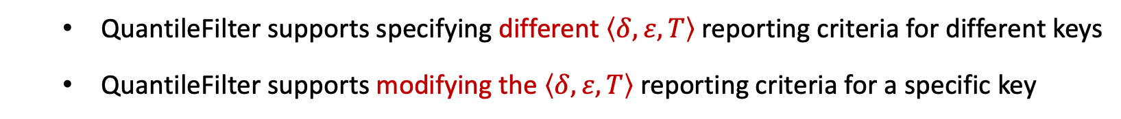
QUANTILE FILTER DESIGN: Flexibility
QuantileFilter supports specifying different $\left\langle δ,ε,T\right\rangle$reporting criteria for different keys
QuantileFilter supports modifying the $\left\langle δ,ε,T\right\rangle$ reporting criteria for a specific key

Slide 17
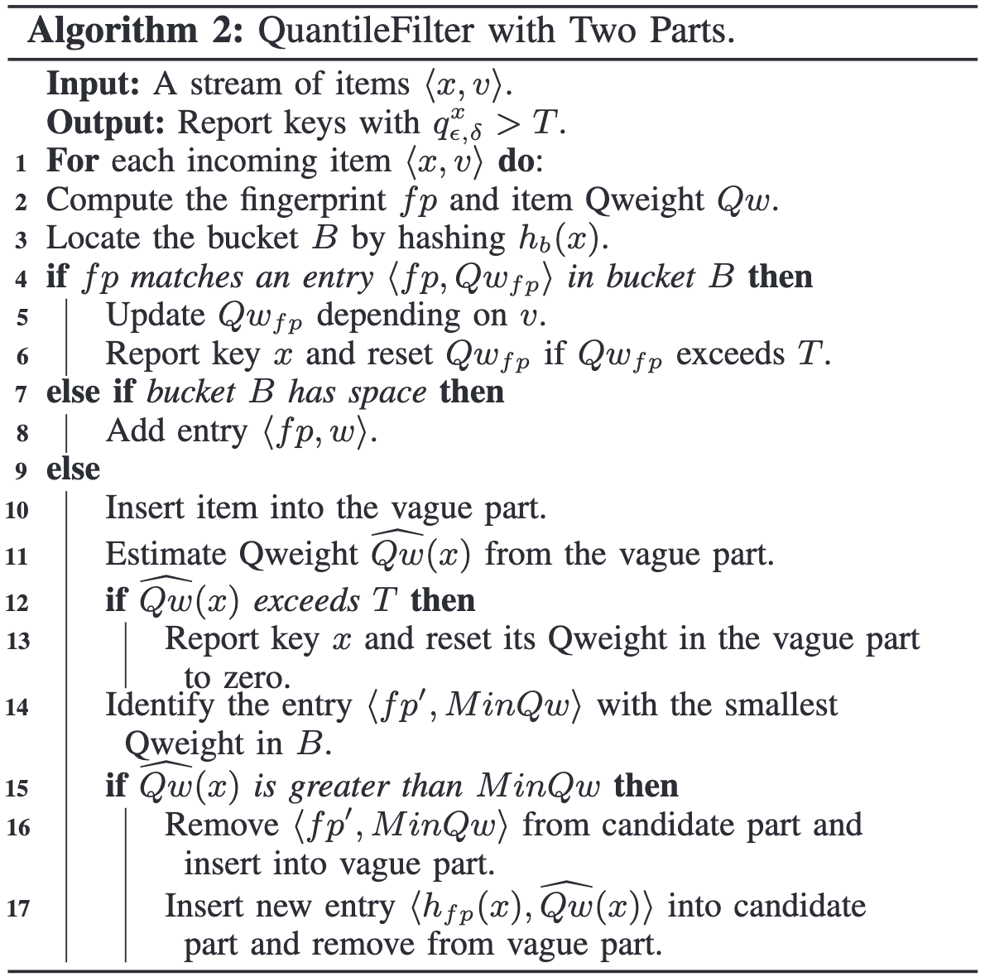
QUANTILE FILTER DESIGN: Flexibility
Choice 1. Strategy in candidate election
Comparative Replacement
Probabilistic Replacement
Forceful Replacement
etc.
Choice 2. Sketch type of the vague part
Csketch
Count-Min Sketch
etc.

Slide 18
EVALUATION
state-of-the-art (SOTA) schemes
SQUAD, SketchPolymer, HistSketch
Datasets
CAIDA dataset, Yahoo Cloud dataset, synthetic Zipf dataset
key results @ Speed.
the processing speed (insertion + querying) of QuantileFilter has improved by 10 to 100 times compared to SOTA schemes.
key results @ Space.
QuantileFilter saves 50 to 500 times more space than SOTA schemes at the same level of accuracy.
Notes:
Now, let us share some important experimental results. We compared our quantile filter with three recent multi-user quantile sketch algorithms on three datasets with different characteristics. The results show that in terms of computational speed, the quantile filter is 10 to 100 times faster than existing algorithms. In terms of space usage, the quantile filter can save 50 to 500 times more space while achieving the same accuracy

Slide 19
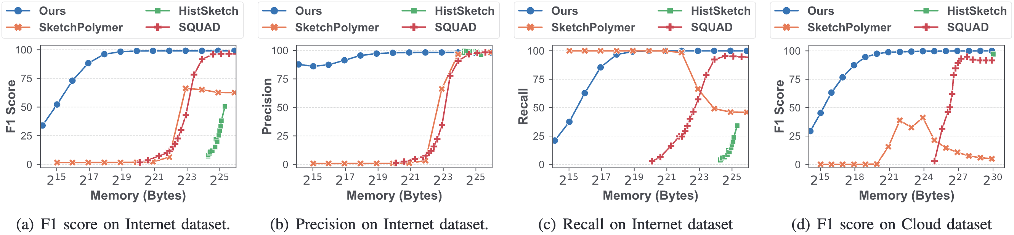
EVALUATION: Accuracy-Space
saving between 50 to 500 times more space than the SOTA algorithms.
under constrained space conditions, our solution attains an F1 accuracy of 99.77%, markedly surpassing the SOTA’s F1 accuracy which falls below 25%.
Notes:
In the trade-off between accuracy and space, we can see that the accuracy of the quantile filter monotonically improves with increased space usage. On different datasets, the quantile filter can achieve nearly 100% accuracy when space usage exceeds 1 million bytes.

Slide 20
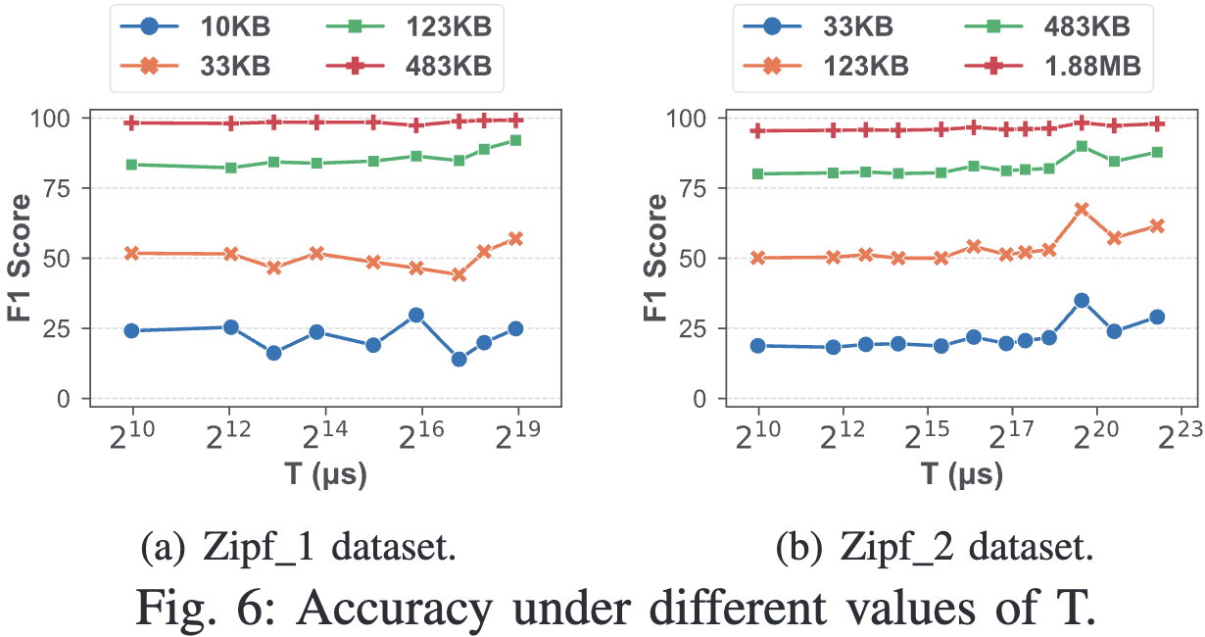
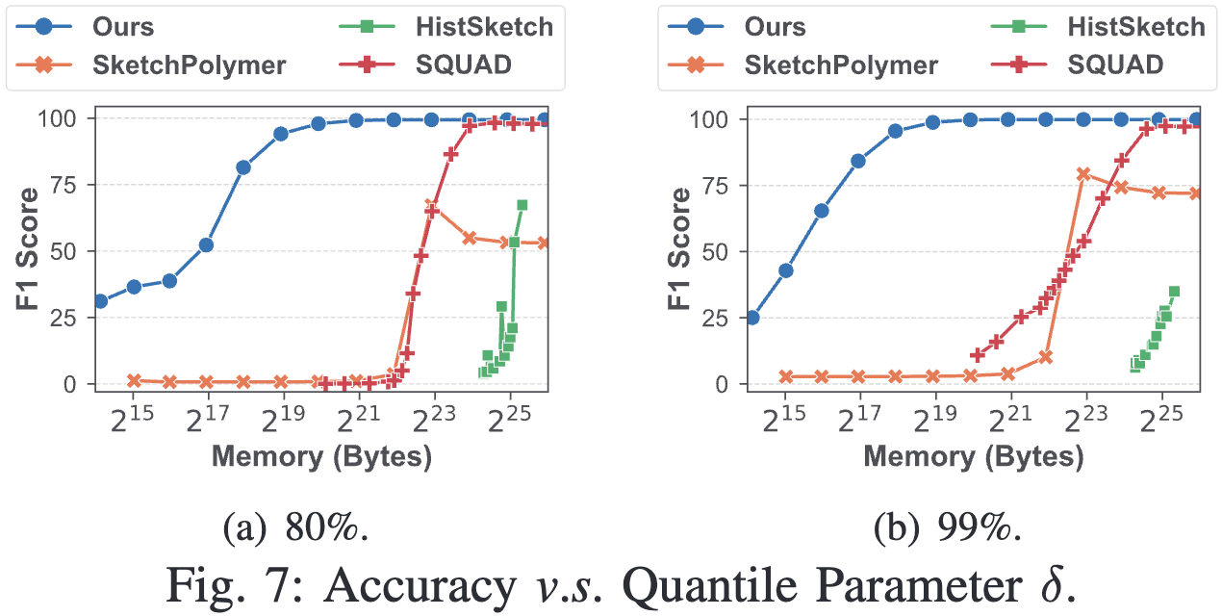
EVALUATION: Accuracy-Space
saving between 50 to 500 times more space than the SOTA algorithms.
under constrained space conditions, our solution attains an F1 accuracy of 99.77%, markedly surpassing the SOTA’s F1 accuracy which falls below 25%.

Slide 21
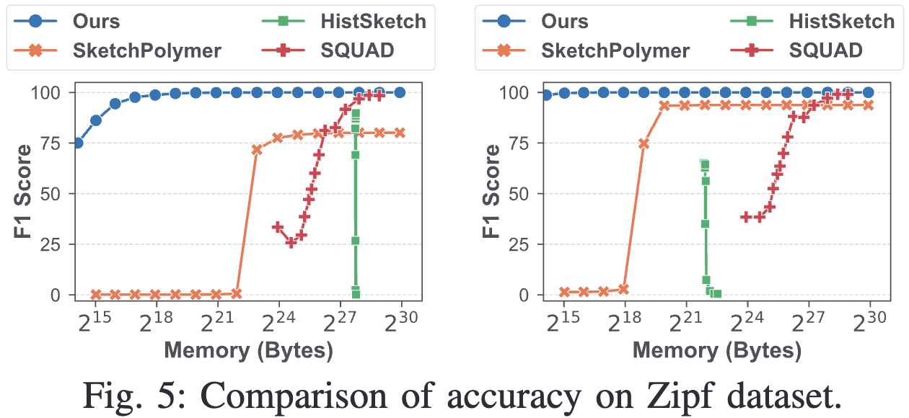
EVALUATION: Accuracy-Space
saving between 50 to 500 times more space than the SOTA algorithms.
under constrained space conditions, our solution attains an F1 accuracy of 99.77%, markedly surpassing the SOTA’s F1 accuracy which falls below 25%.

Slide 22
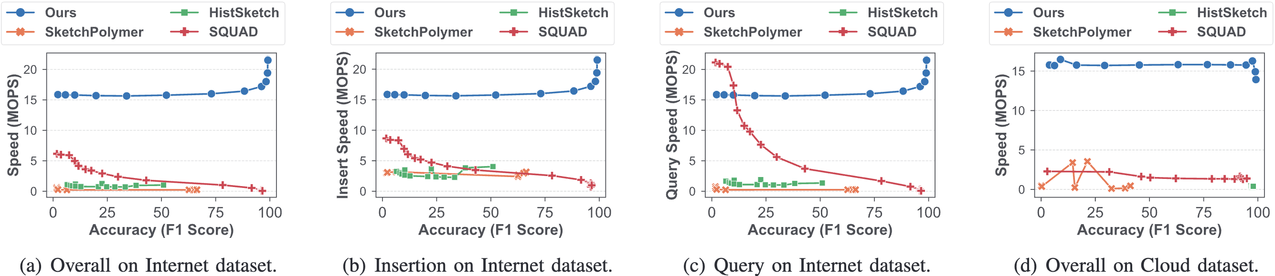
EVALUATION: Experiments on Speed
Overall, when accuracy exceeds 50%, our algorithm achieves a speed enhancement of 10 to 100 times compared to SOTA.
when memory limitations are expanded, our strategy further accelerating solution’s speed as space increases and precision improves.
Notes:
In the trade-off between accuracy and speed, the quantile filter performs very impressively. We found that the quantile filter can achieve throughput exceeding 15 million operations per second. Furthermore, as space usage increases, not only does accuracy improve, but computational speed also increases. This is because more space usage means more insertion operations only need to access the candidate part without accessing the vague part. This property is different from all other algorithms.

Slide 23
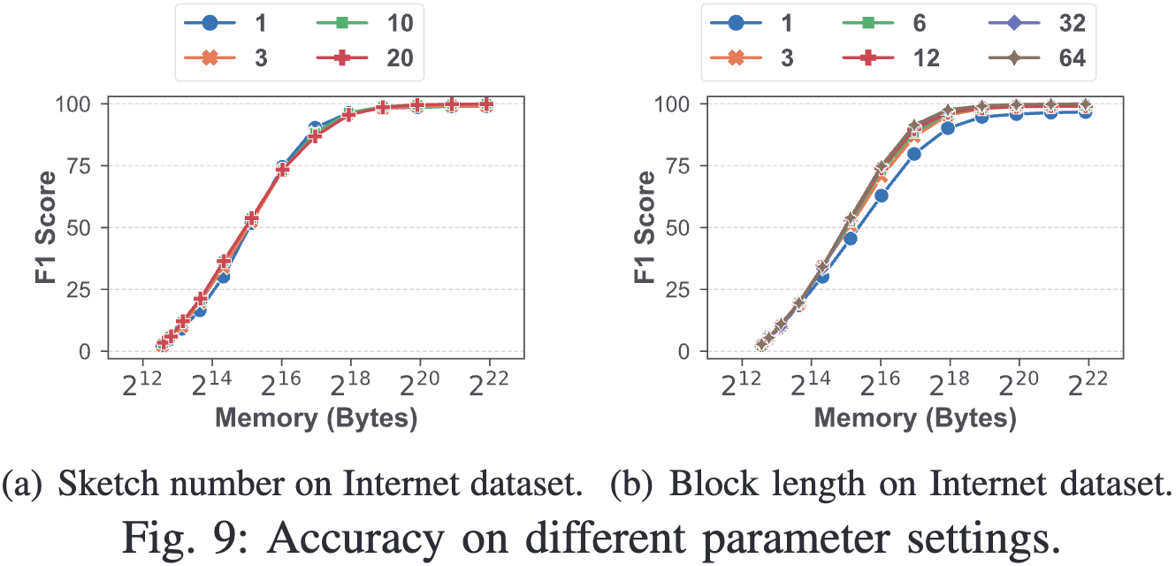
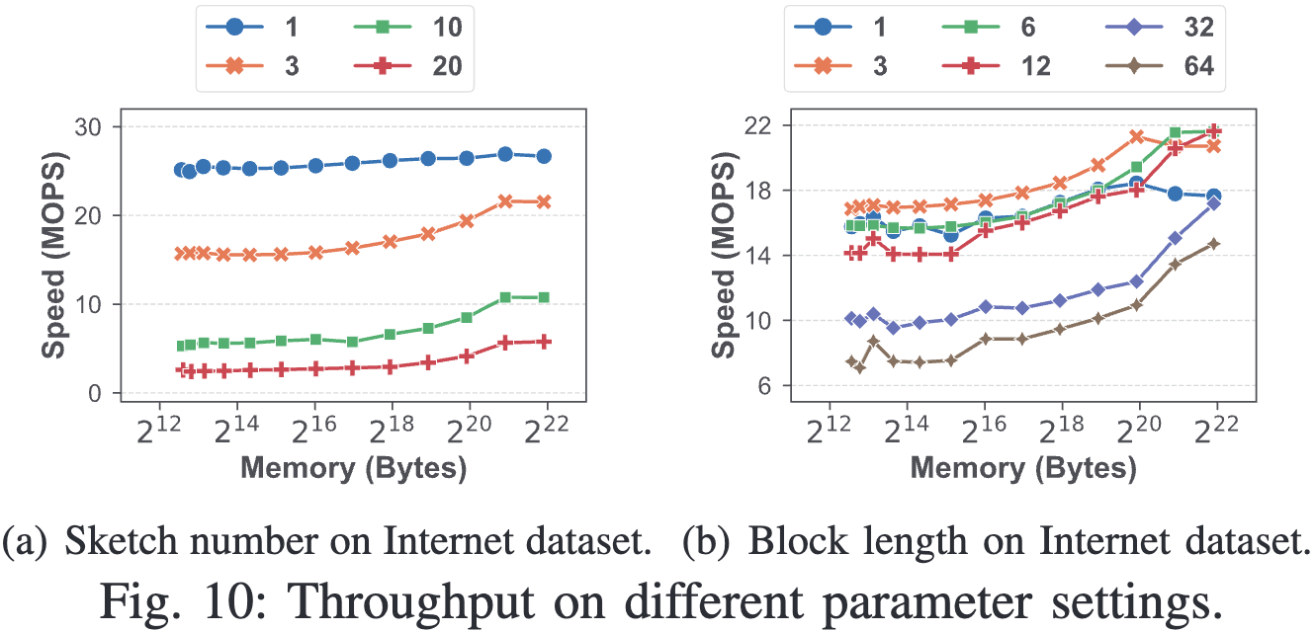
EVALUATION: In-Depth Exploration of QuantileFilter
the impact of various algorithmic parameters and versions on QuantileFilter.

Slide 24
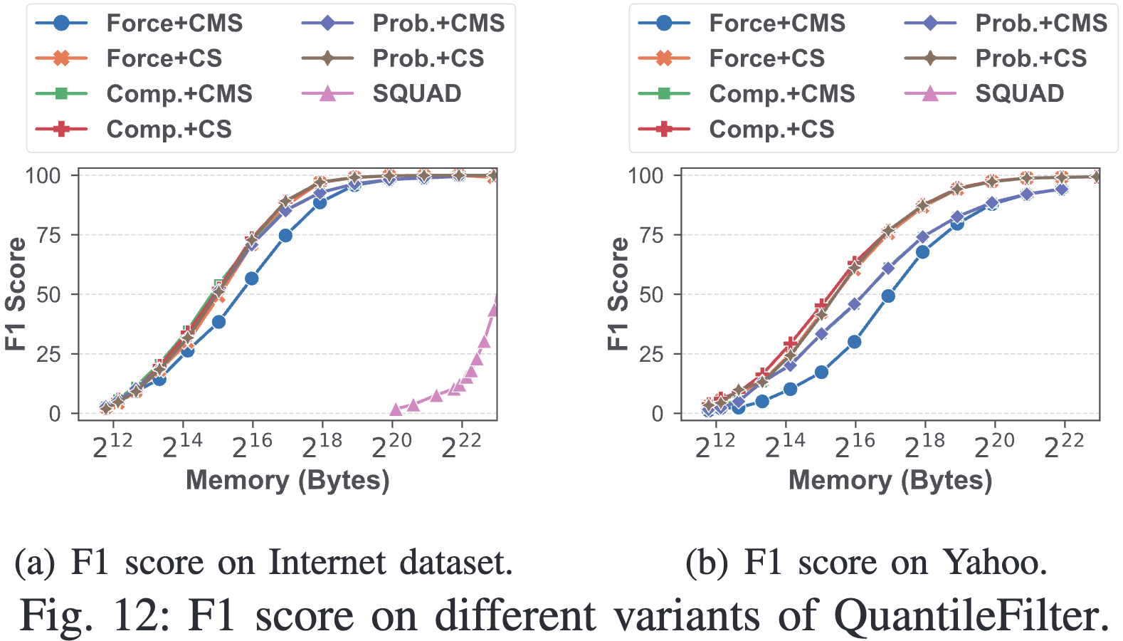
EVALUATION: In-Depth Exploration of QuantileFilter
the impact of various algorithmic parameters and versions on QuantileFilter.
Choice 1. Strategy in candidate election
Choice 2. Sketch type of the vague part

Slide 25
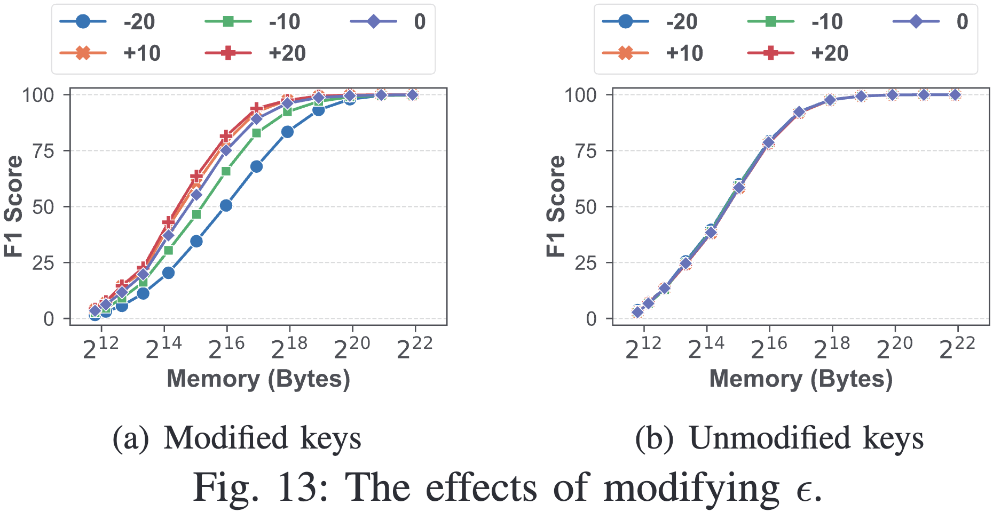
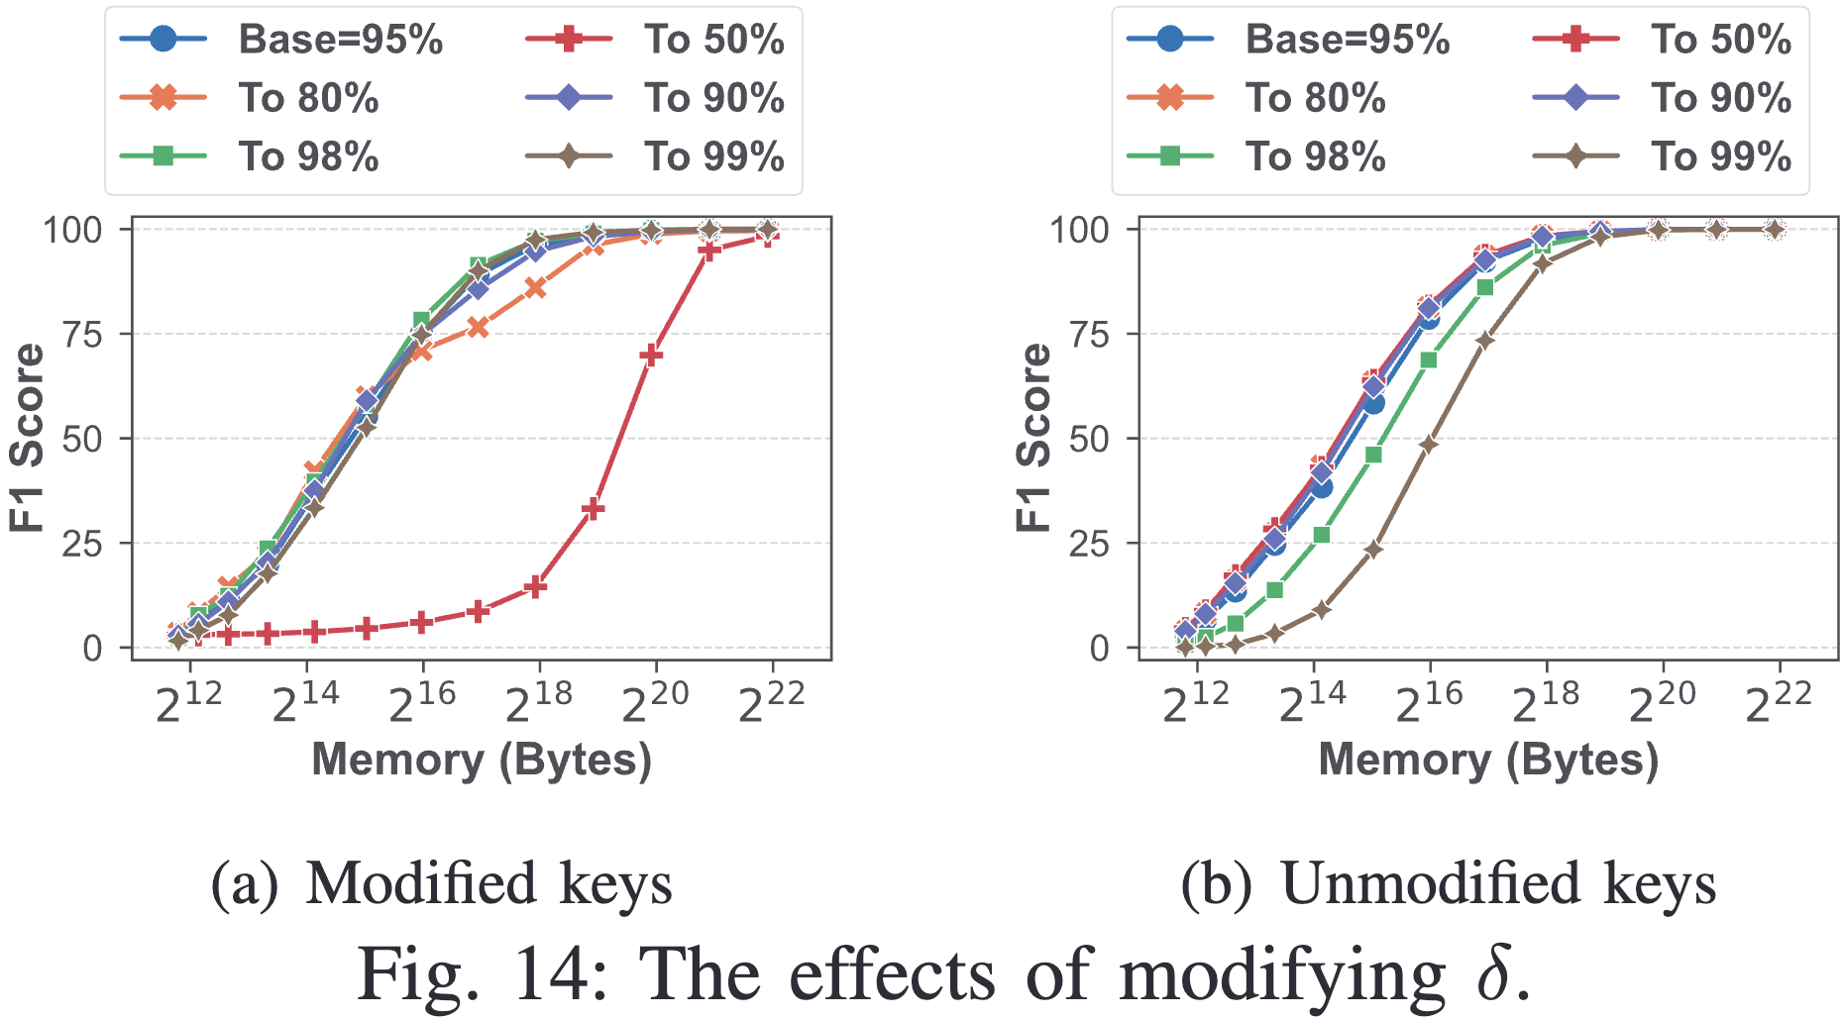
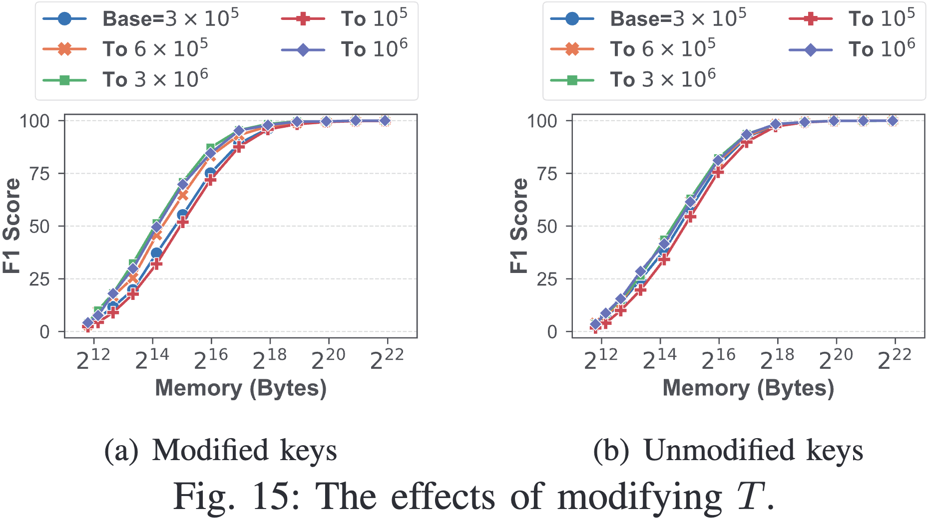
EVALUATION: In-Depth Exploration of QuantileFilter
Effects of Dynamic Modification of Criteria
For a chosen parameter, we modify it for half the keys, then compare the accuracy of modified and unmodified keys against the baseline scenario without modifications.

Slide 26
Conclusion
Fast online computation: QuantileFilter processes each data item in constant time.
Technique I. For fast online computation, we integrate the insert of incoming data and the query.
Efficient space usage: QuantileFilter saves up to 500 times space compared to SOTA solutions with the same high accuracy.
Technique 2. For efficient space usage, we devise a compact and high-accuracy sketch to estimate Qweight, achieving efficient outstanding key report
E-mail: zyk@pku.edu.cn
E-mail: yuhan.wu@pku.edu.cn
Notes:
Finally, to summarize, we proposed the quantile filter, an online algorithm for real-time monitoring of Outstanding Quantiles. It has two important properties: fast online computation with constant time and up to 500 times more efficient space usage than existing algorithms. Thank you for listening! We welcome questions about our work, and now Yuhan Wu will answer your questions.
15 MIN

